Slide 1
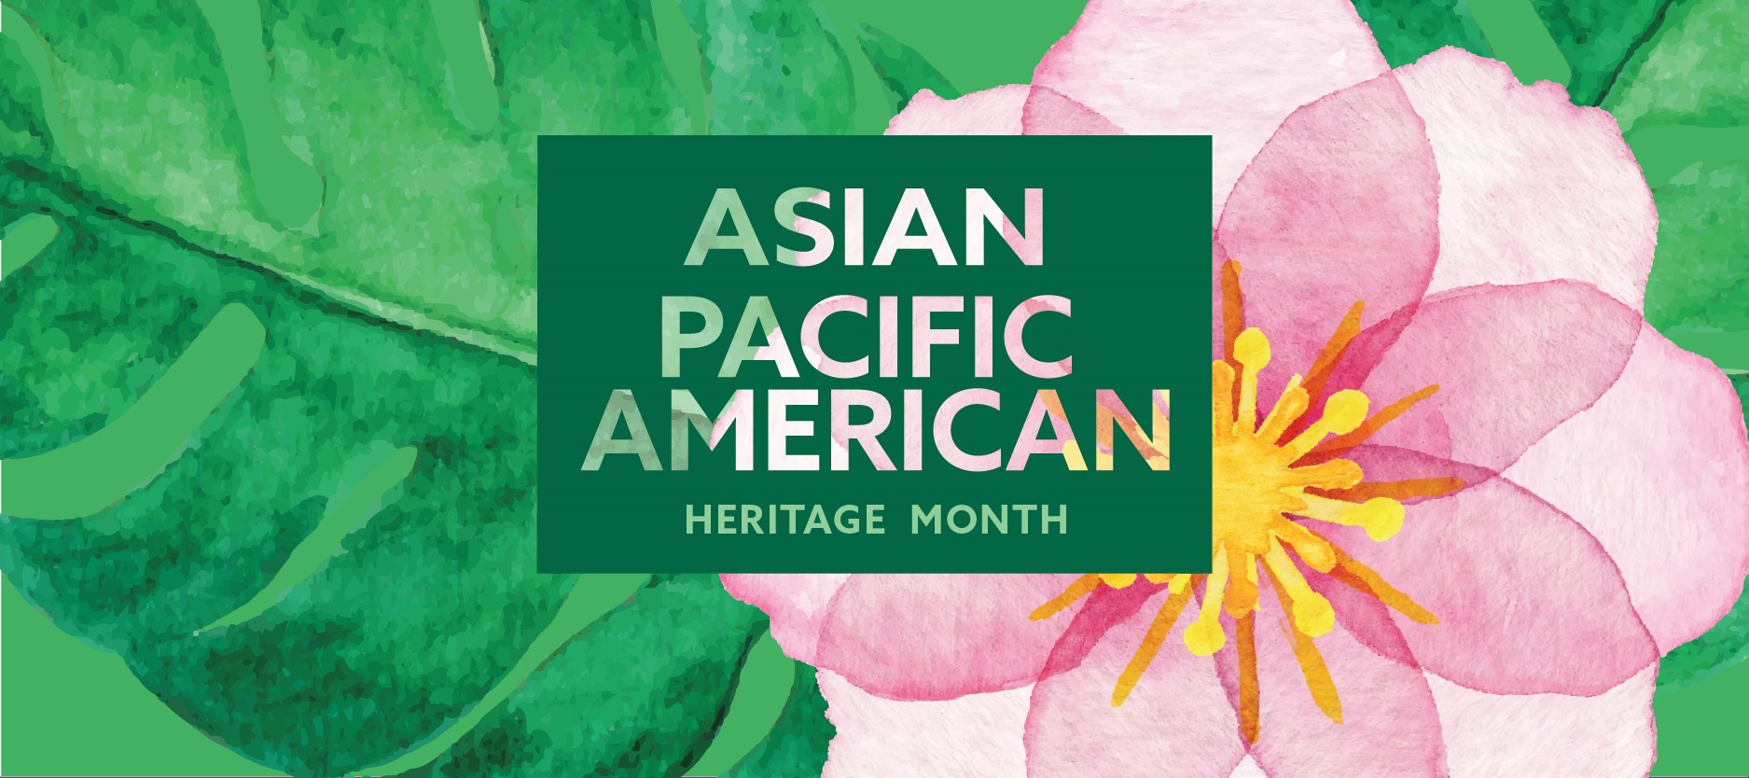
Presented by: The Office of Diversity and Inclusion

Slide 2
What is Asian Pacific American Heritage Month?
Asian Pacific American Heritage Month became a national weekly observance in 1979, scheduled to coincide with anniversaries of the completion of the transcontinental railroad -- built largely by Chinese immigrants -- and the arrival of the first Japanese immigrants to the U.S.
In 1992 the observance became a permanently designated month to celebrate all Asian Pacific American communities.

Slide 3
What is Asian Pacific American Heritage Month?
Asian/Pacific encompasses all of the Asian continent and the Pacific islands of
Melanesia (New Guinea, New Caledonia, Vanuatu, Fiji and the Solomon Islands)
Micronesia (Marianas, Guam, Wake Island, Palau, Marshall Islands, Kiribati, Nauru and the Federated States of Micronesia)
Polynesia (New Zealand, Hawaiian Islands, Rotuma, Midway Islands, Samoa, American Samoa, Tonga, Tuvalu, Cook Islands, French Polynesia and Easter Island).

Slide 4
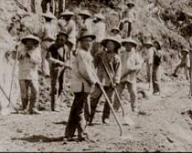
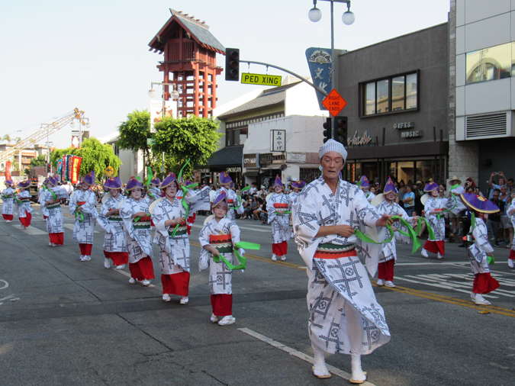
1934- Nisei Week founded- Japanese- American celebration of culture
1790- First Asian Indians arrive in America
1830- First record of Chinese immigrants in America
1763- First Filipinos arrive in America
1843- First Japanese arrive in America
1865- Chinese immigrants begin working on transcontinental railroad

Slide 5
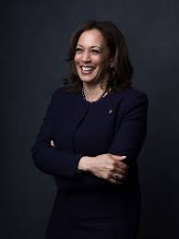
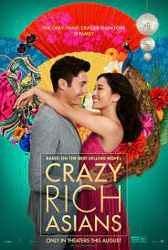
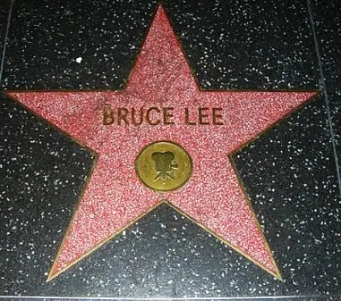
1990- Asian Pacific American Heritage Month established
2020- Kamala Harris is elected as Vice President of the United States
1956- Dalip Singh Saund, first Asian Indian elected to congress
1968- Hart-Cellar Act- Granted the right for Asians to immigrate to America
1941- Japanese internment camps established as a result of the attack on Pearl Harbor
1973
2018- Crazy Rich Asians tops charts with all Asian cast
Bruce Lee becomes first Asian Hollywood star

Slide 6
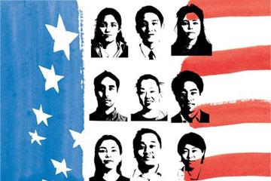
Did you know?
More than 50% of all Asian Americans live in just three states: California, New York, and Hawaii.
More than half of all American Pacific Islanders live in two states: Hawaii and California.

Slide 7
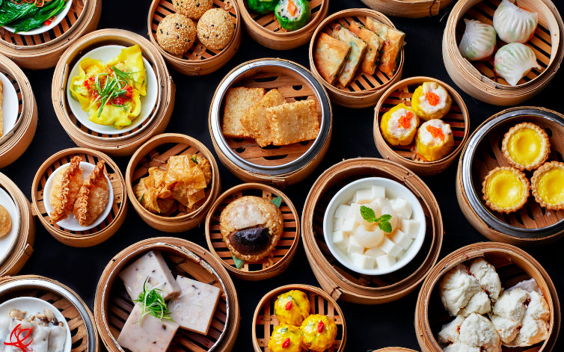
Asian Pacific American Contributions
Cuisine
Popularity of Asian cuisine in United States dates back to 19th century
Several of the largest restaurant chains in the US include P.F. Chang’s, Panda Express and others, as well family-owned restaurants came to be integral neighborhood favorites places to get sushi, pho, Thai or Indian meals
Asian American chefs have been featured on multiple food series such as Iron Chef, Master Chef, and others

Slide 8
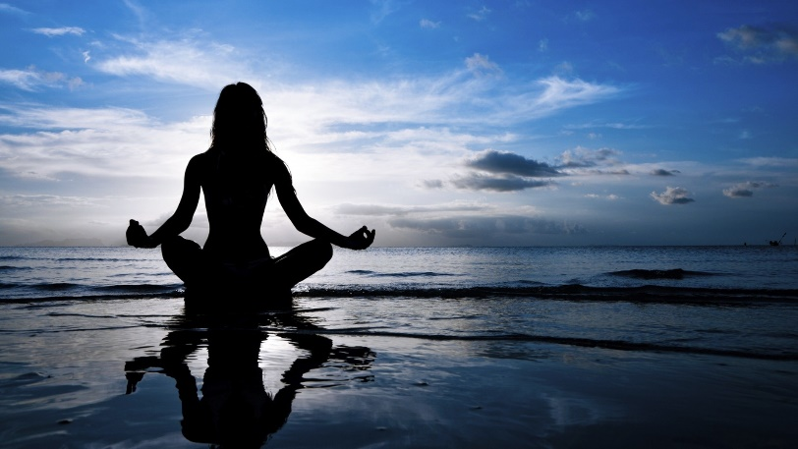
Asian Pacific American Contributions
Wellness
Many Americans benefit daily from practicing meditation, yoga, tai chi and other forms of wellness practices and exercises
Acupuncture, reflexology and herbalism are essential healing elements in many peoples lives
Ayurvedic medicine has gained popularity and offers many benefits as a chosen lifestyle or as a natural therapy
Mindfulness practice has been integrated in many people’s lives as well as psychotherapy modalities

Slide 9
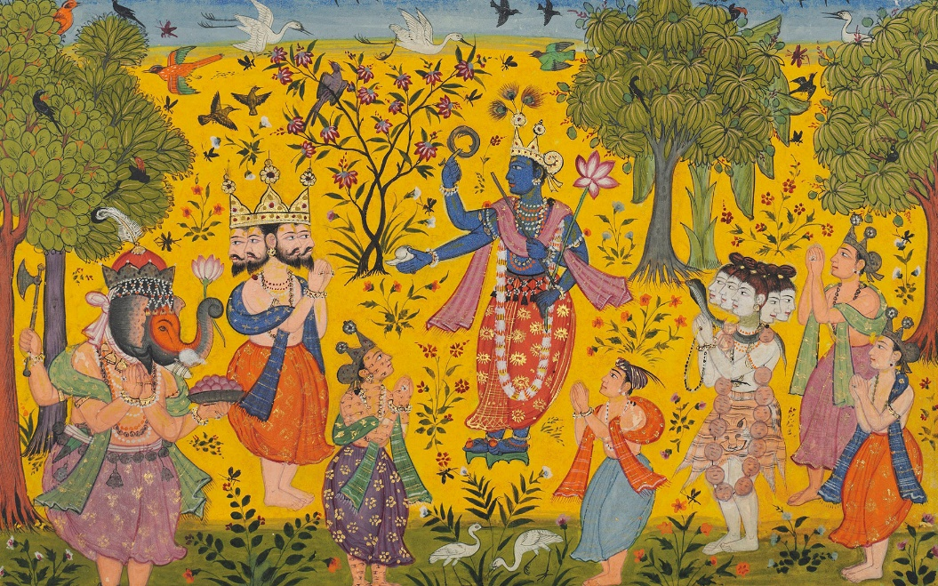
Asian Pacific American Contributions
Arts and Entrainment
Bollywood
Manga
Anime
Origami
Calligraphy
K-Pop
Feng Chui
Martial Arts
Kabuki

Slide 10
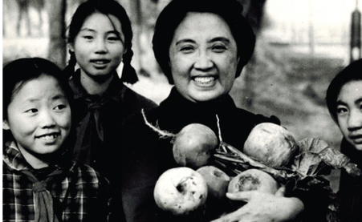
Joyce Chen
1917-1994
Chinese-American Chef, Restaurateur, and Author
Pioneer of bringing Northern Chinese Cuisine to the U.S.

Slide 11
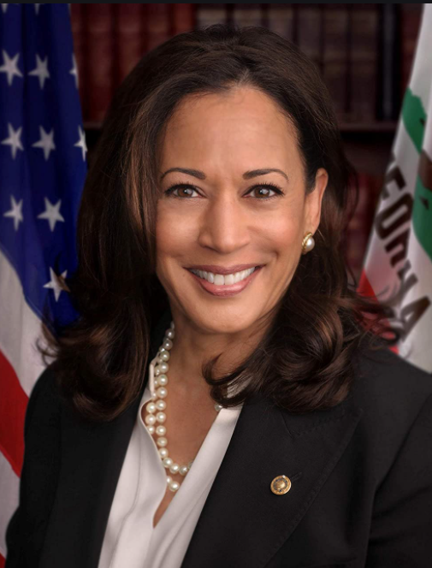
Kamala Harris
1964-
First Asian-American U.S. Vice-President

Slide 12
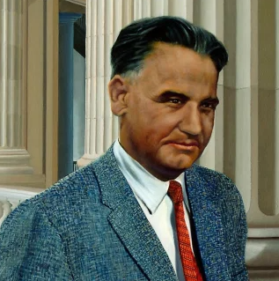
Dalip Singh Saund
1899-1973
1st Sikh-American, 1st Asian-American, and 1st Indian-American to be elected to the U.S. Congress

Slide 13
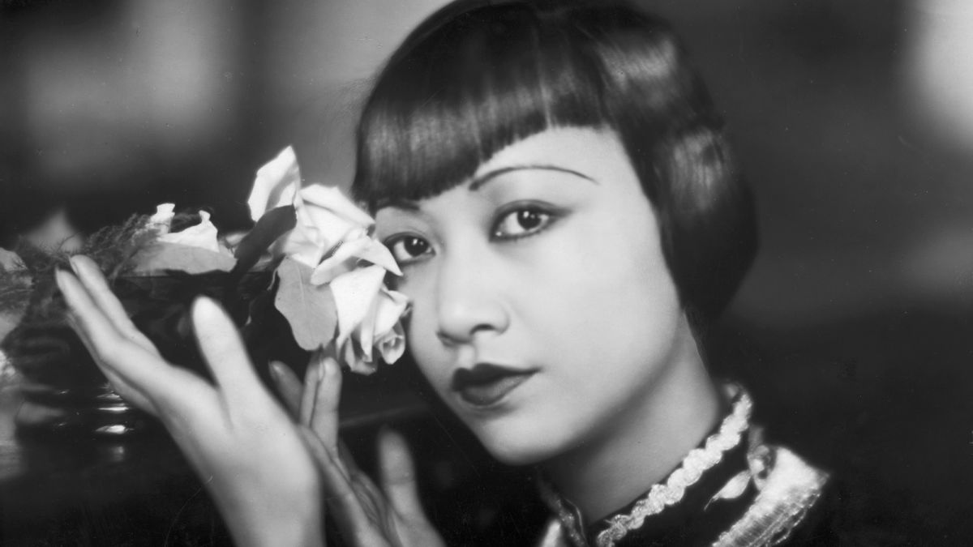
Anna May Wong
1905-1961
First Chinese-American Movie Star

Slide 14
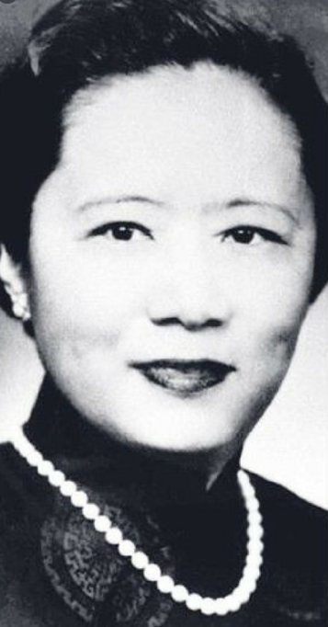
Chien-Shiung Wu
1912-1997
Chinese-American Nuclear Physicist
Named the First Lady of Physics
1st Female Faculty in Princeton Physics Dept
Collaborated on Manhattan Project

Slide 15
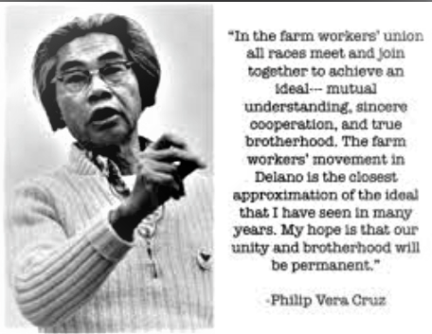
Philip Vera Cruz
1904-1994
Filipino-American Labor Leader and Civil Rights Activist

Slide 16
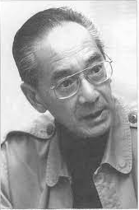
Yuji Ichioka
1936-2002
Japanese-American Historian and Civil Rights Activist

Slide 17
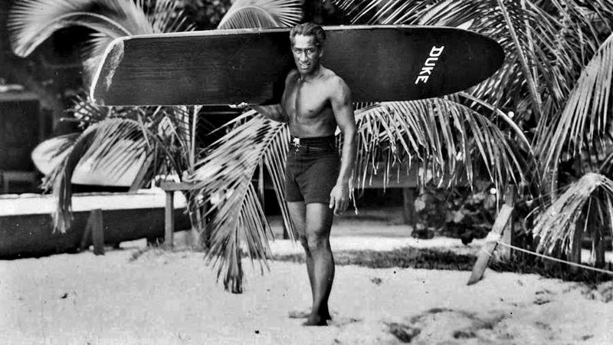
Did you know ?
The people of Hawaii referred to surfing as he’enalu, which means “wave sliding.” For Hawaiians, surfing was a central part of their religion. Surfing not only encompassed deep spiritual links with the ocean, but it was also a way for ceremonial chiefs to assert their dominance.

Slide 18
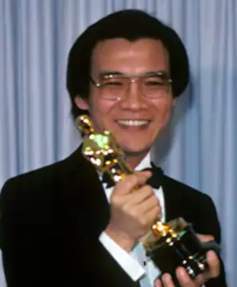
Haing S. Ngor
1940-1996
Cambodian-American Surgeon, Actor and Author
Only actor of Asian descent to ever win an Academy Award for Best Supporting Actor (The Killing Fields)

Slide 19
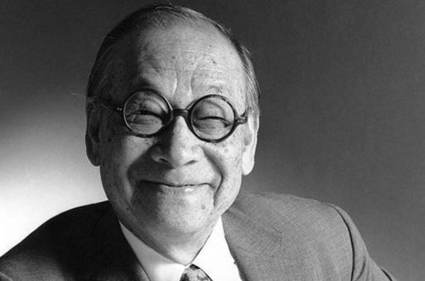
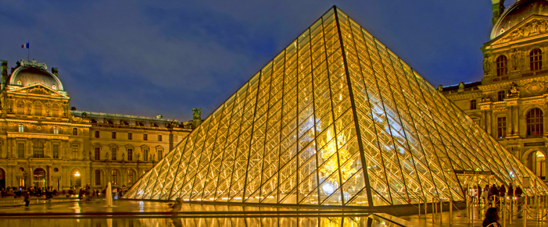
I.M. Pei
1917-2019
Chinese-American Architect

Slide 20
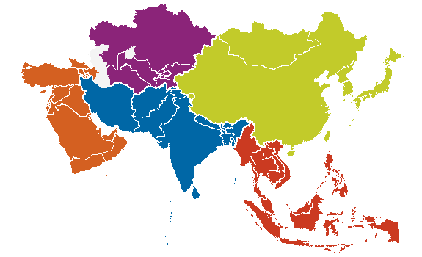
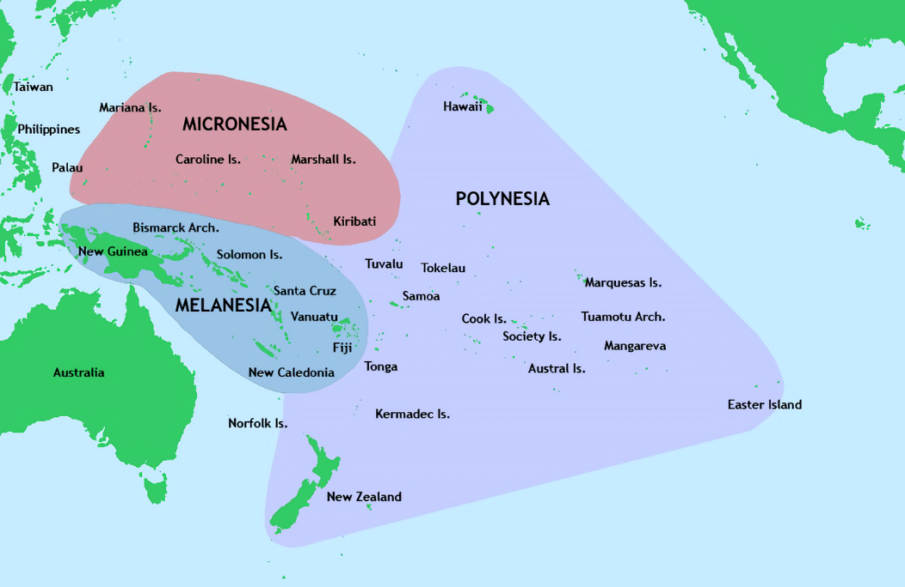
Did you know ?
There are nearly 1,400 different languages spoken across Asia and the Pacific Islands?

Slide 21
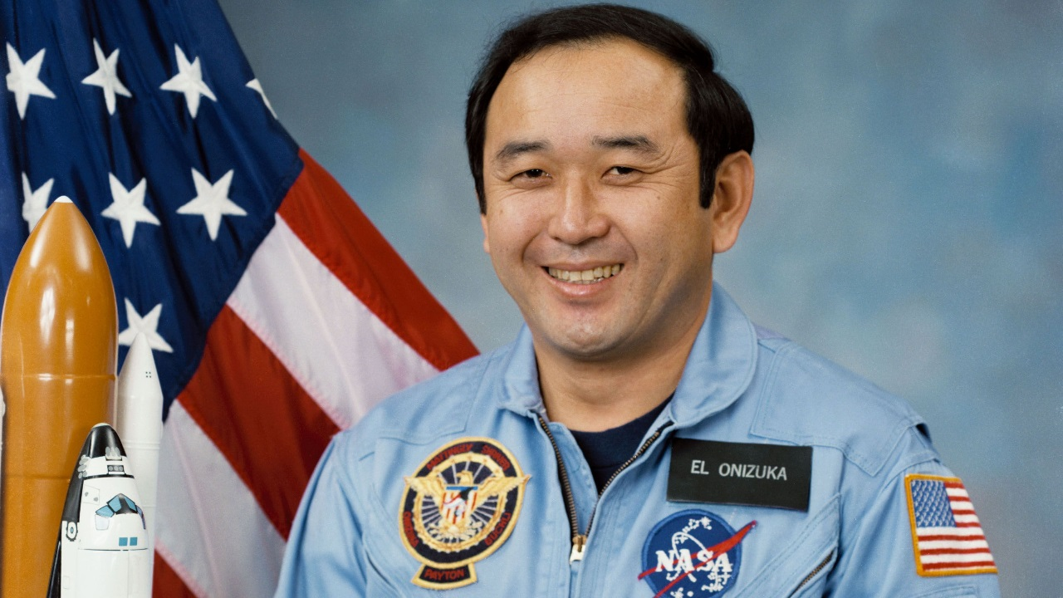
Ellison Onizuka
1946-1986
First Asian-American, Japanese-American, and Hawaiian in space

Slide 22
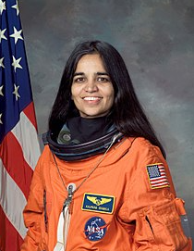
Kalpana Chawla
1961-2003
First Indian-American Woman in space

Slide 23
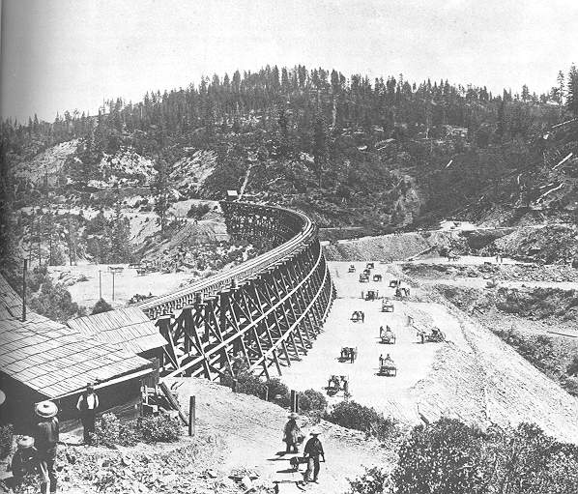
Did you know ?
2/3 of the workers who completed the transcontinental railroad were Chinese.
Without the efforts of the Chinese workers in
the building of America's railroads,
our development and progress as a nation
would have been delayed by years.

Slide 24
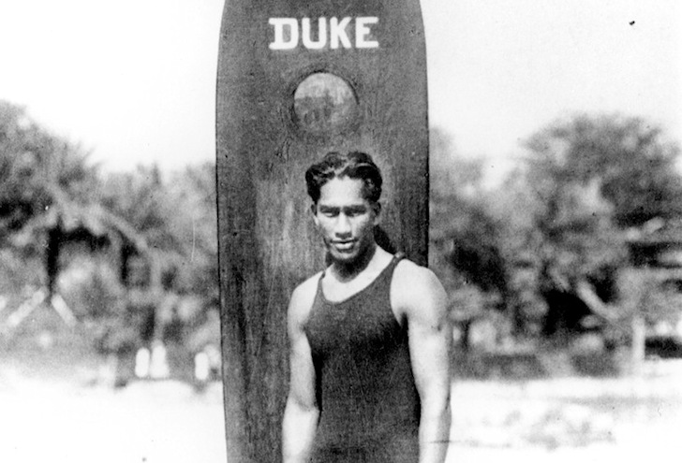
Duke Kahanamoku
1890-1968
Native Hawaiian Olympic Gold Medalist, Surfer and Actor

Slide 25
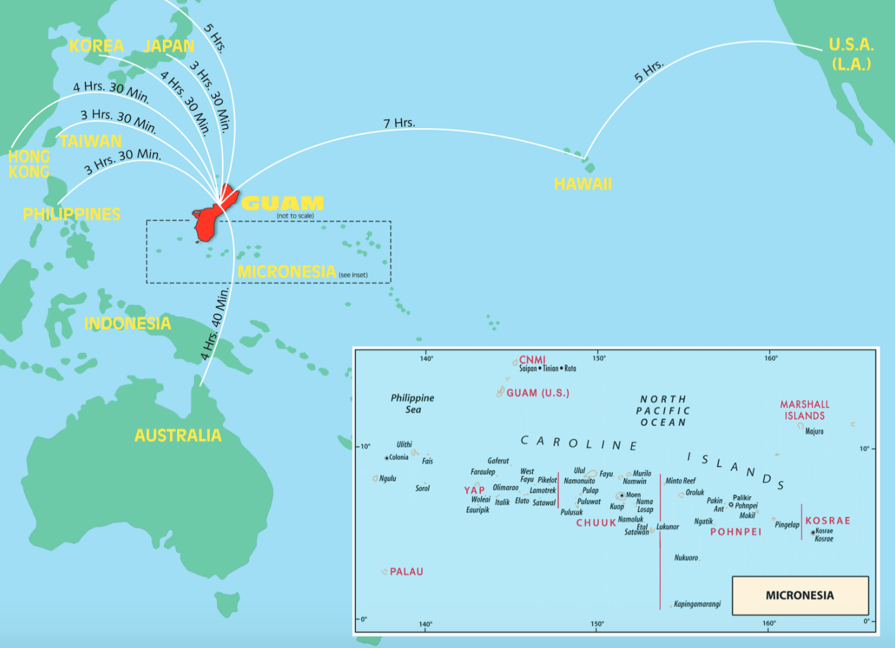
Did you know ?
The U.S. territory of Guam is nearly 8,000 miles away from Washington D.C.. Making it further than:
Beijing, China (6,798 mi)
Delhi, India (7,472 mi)
Cape town, South Africa (7,894 mi)
Buenos Aires, Argentina (7,472 mi)

Slide 26
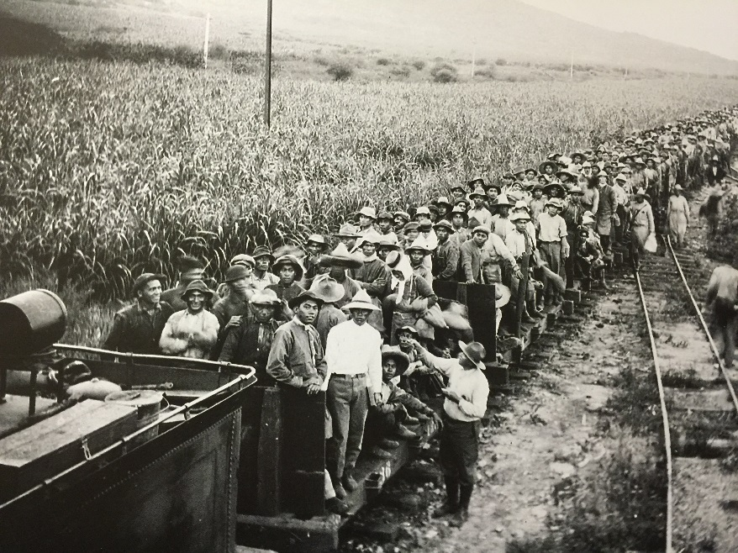
Did you know?
Hawaiian Pidgin is a unique mixture of words, phrases, and idioms drawn from the many languages and cultures (e.g. Hawaiian, Japanese, Chinese, Filipino, and Portuguese) that make up Hawaii. Pidgin was developed when Native Hawaiians, immigrant laborers, and plantation owners needed to communicate with each other.

Slide 27
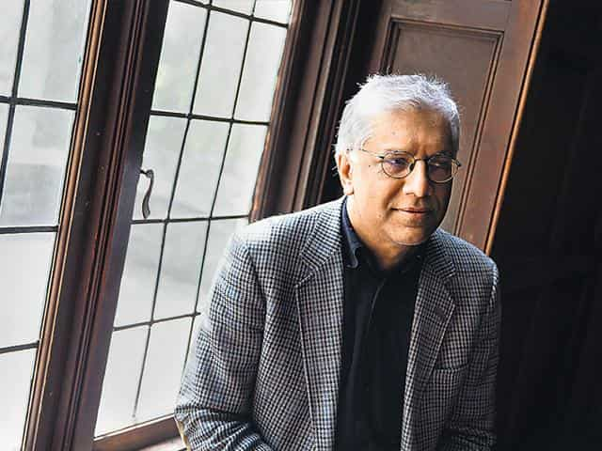
Vijay Seshadri
1954-
First Indian-American to win a Pulitzer Prize for poetry

Slide 28
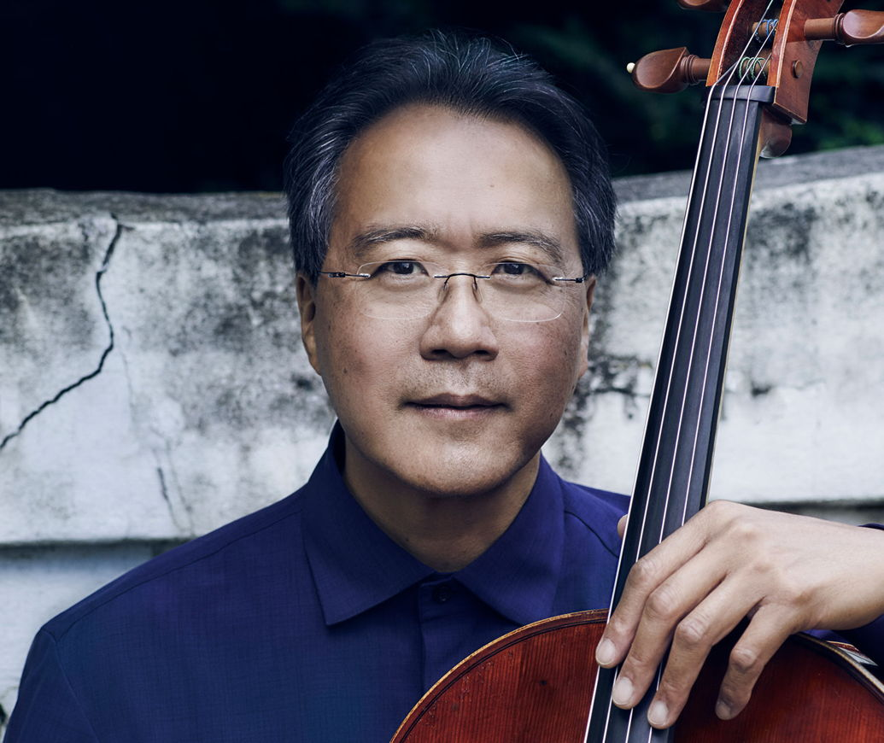
Yo-Yo Ma
1955-
Chinese-American Classical Musician and Performer

Slide 29
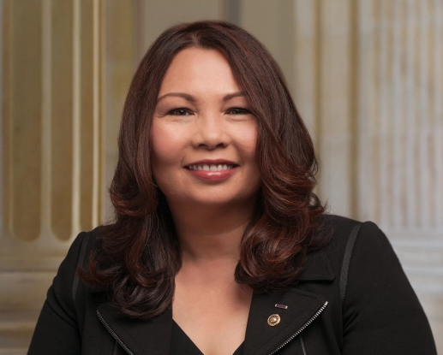
Tammy Duckworth
1968-
Thai-American Army Veteran and U.S. Senator
1st Thai-American woman elected to U.S. Congress, 1st person born in Thailand to be elected to U.S. Congress, 1st woman with a disability elected to U.S. Congress, 1st female double amputee in the Senate, and 1st U.S. senator to give birth while in office

Slide 30
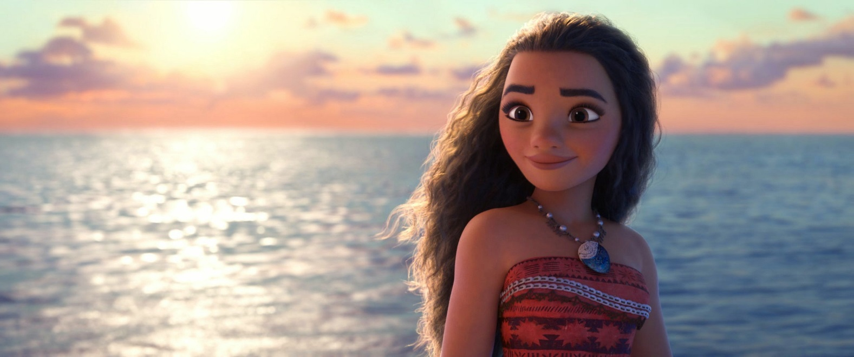
Did you Know ?
Disney’s “Moana” is the first film ever translated into the “Tahitian” language.

Slide 31
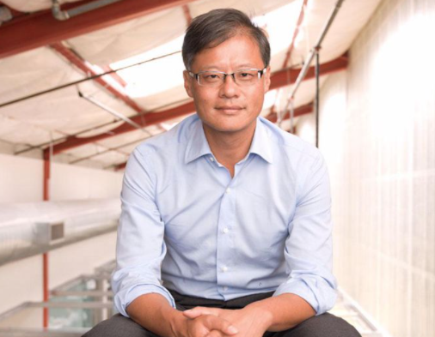
Jerry Yang
1968-
Taiwanese American Co-Founder of Yahoo! and Tech Investor

Slide 32
Awkwafina
1988-
First Asian-American to Win Best Actress at Golden Globes

Slide 33
Mohini Bhardwaj
1978- First Indian-American Olympic medalist

Slide 34
Naomi Uemura 1941 –1984
Uemura was the first person in history to reach the North Pole alone. Uemura was also the first man to climb Mount McKinley solo in 1970 and the first Japanese man to climb Mount Everest

